Slide 1


Azure’s Cloud Platform Building serverless applications
Eldert Grootenboer

Slide 2

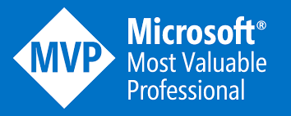

Eldert Grootenboer
@egrootenboer
Notes:
Cloud Solution Architect
Microsoft Azure MVP
SME IoT
International Speaker
Blogger
Global Integration Bootcamp
Azure IoT Community
Published Author
InfoQ
Boat enthusiast

Slide 3
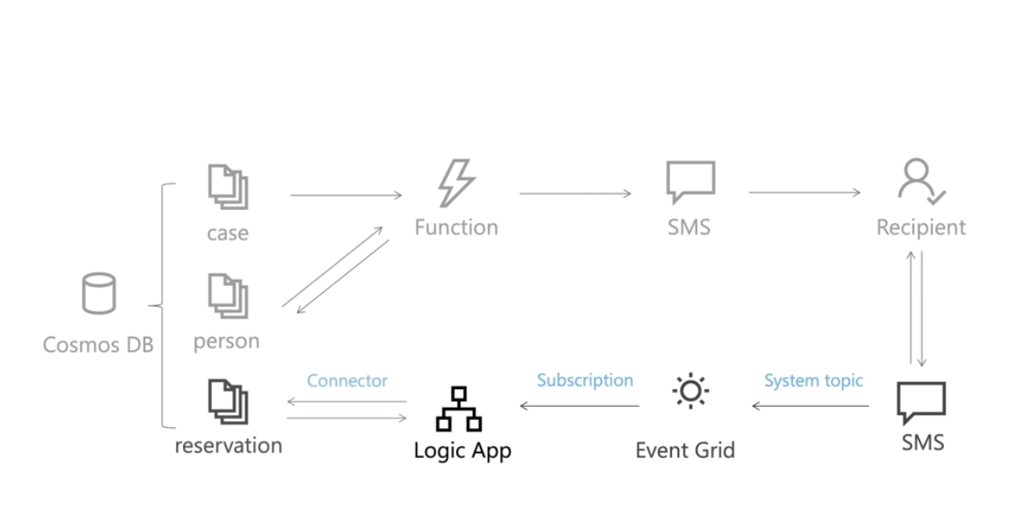
Possible scenario

Slide 4
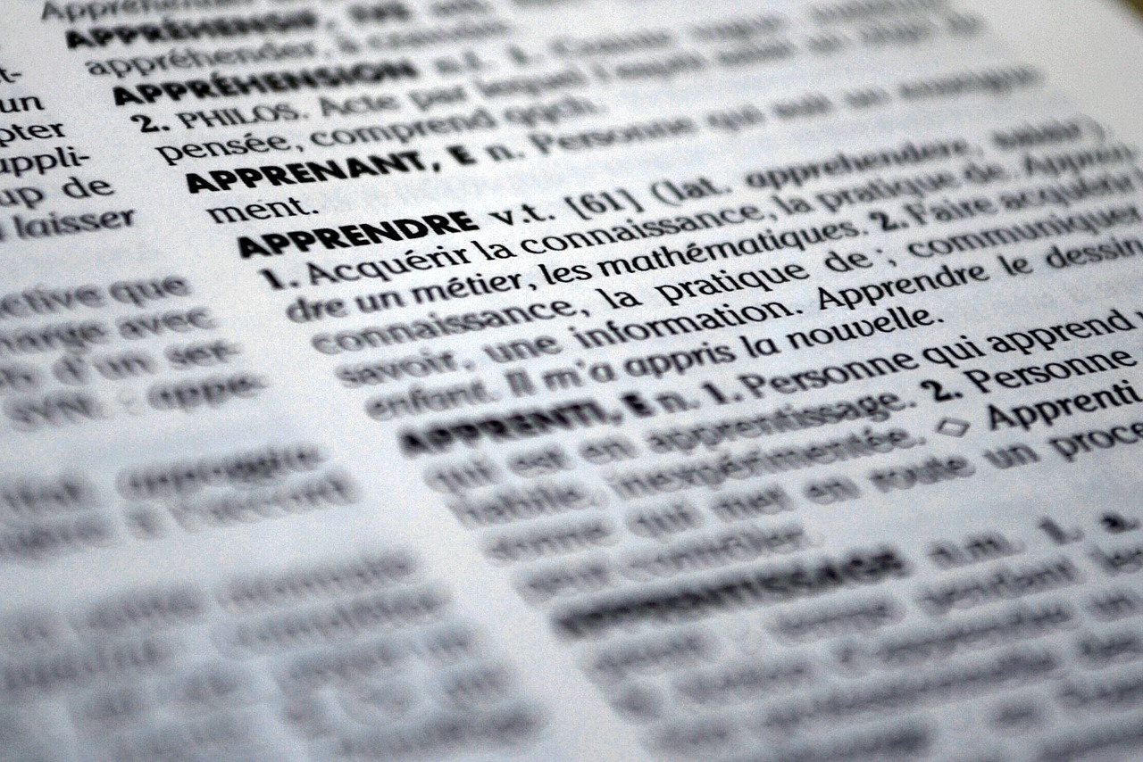
Defining Serverless
“Serverless computing is a cloud-computing execution model in which the cloud provider dynamically manages the allocation of machine resources. Pricing is based on the actual amount of resources consumed by an application, rather than on pre-purchased units of capacity. It is a form of utility computing.”
Source (Wikipedia Serverless Computing): https://en.wikipedia.org/wiki/Serverless_computing
Notes:
Abstraction of servers & platforms, event driven, event scale, micro-billing, DevOps productivity, focus on business logic, faster time to market!

Slide 5
Evolution to Serverless

Slide 6
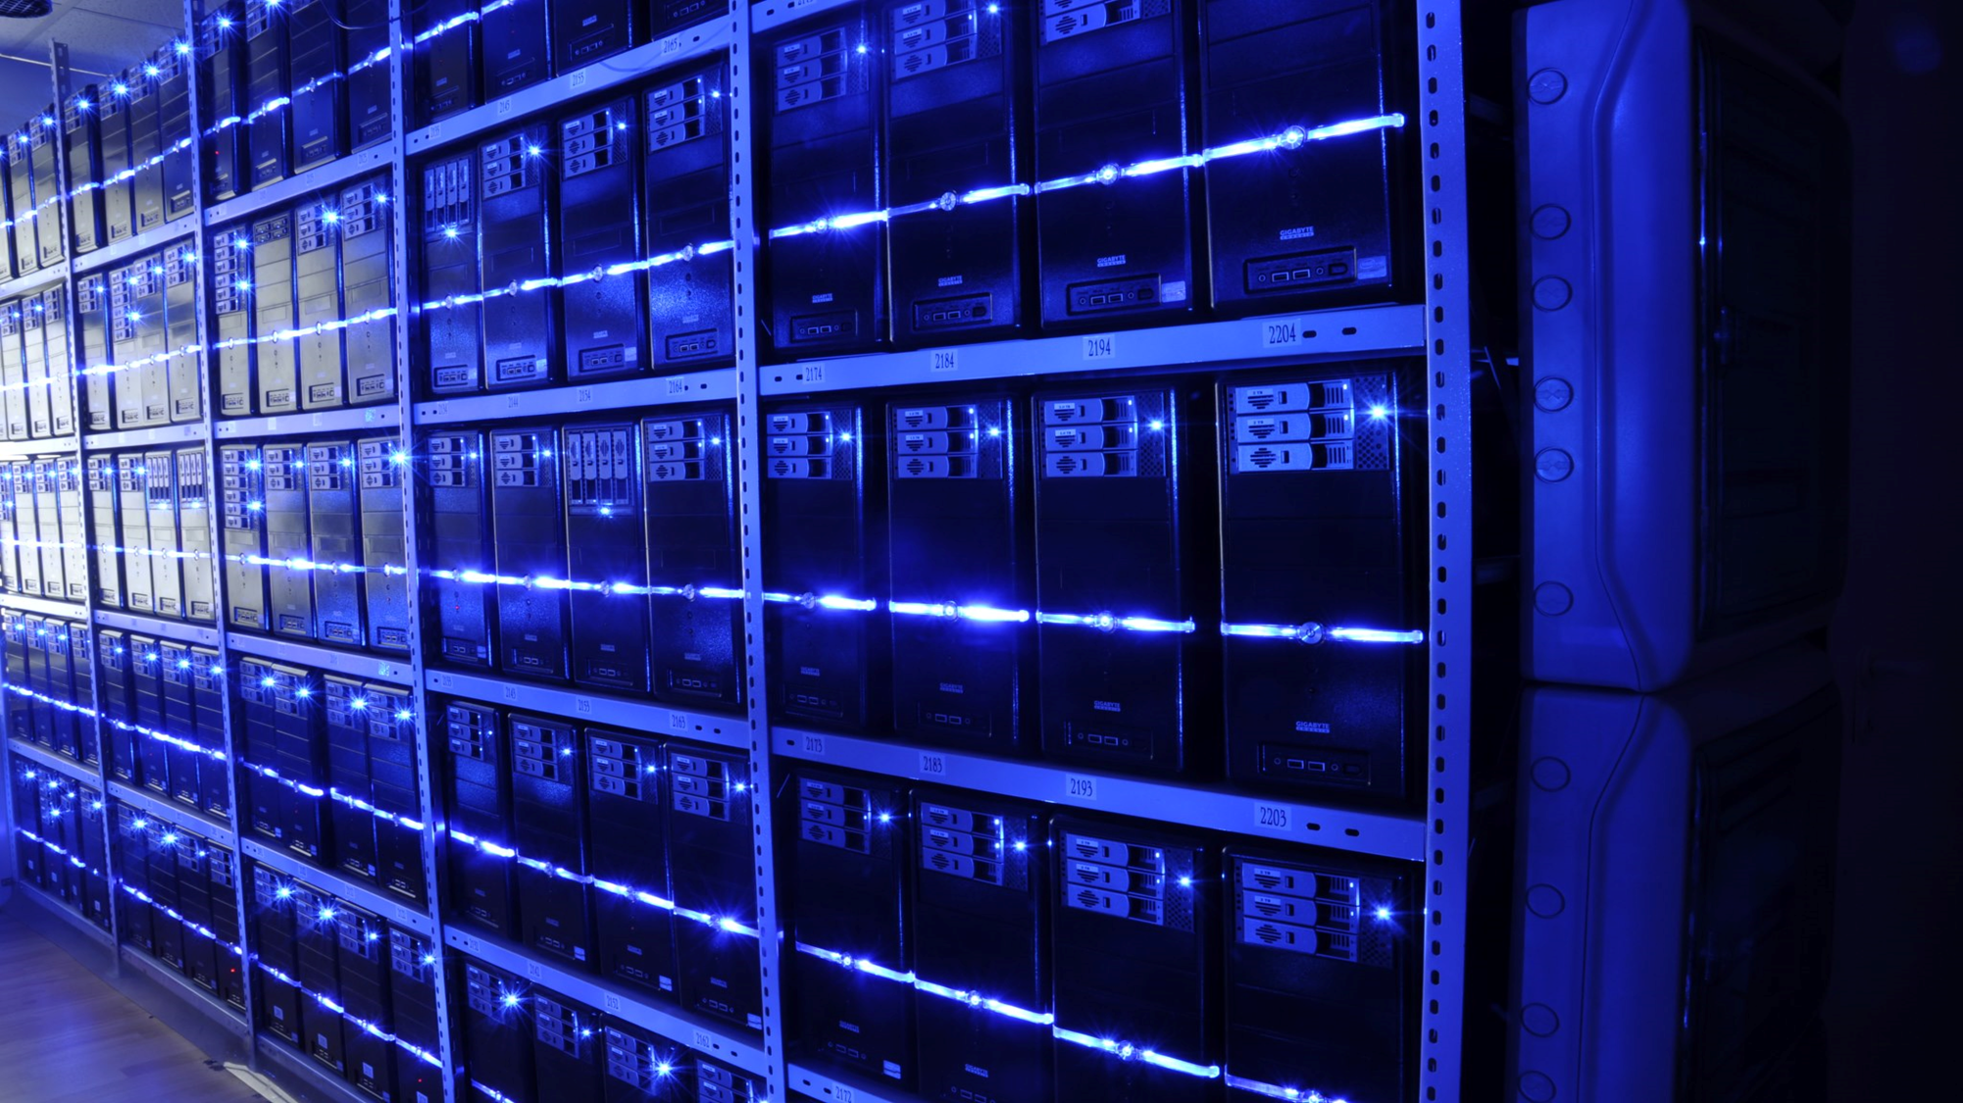
What is the right size of
servers for my business needs?
How do I deploy new code to my server?
What media should I
use to keep backup?
What happens in case of
server hardware failure?
Which packages should be on my server?
What size of servers
should I buy?
Who monitors
my App?
How often should I backup my server?
How can I scale my app?
How can I increase server utilization?
Who has physical
access to my servers?
Which OS should I use?
Do I need secondary network connection?
Are my server in a
secure location?
What happens if the
power goes out?
Who monitors
my Servers?
Do I need a UPS?
What storage I need to use?
How many servers
do I need?
How can I dynamically configure my app?
It takes how long to provision a new server?
How often should
I patch my servers?
On-Premises

Slide 7
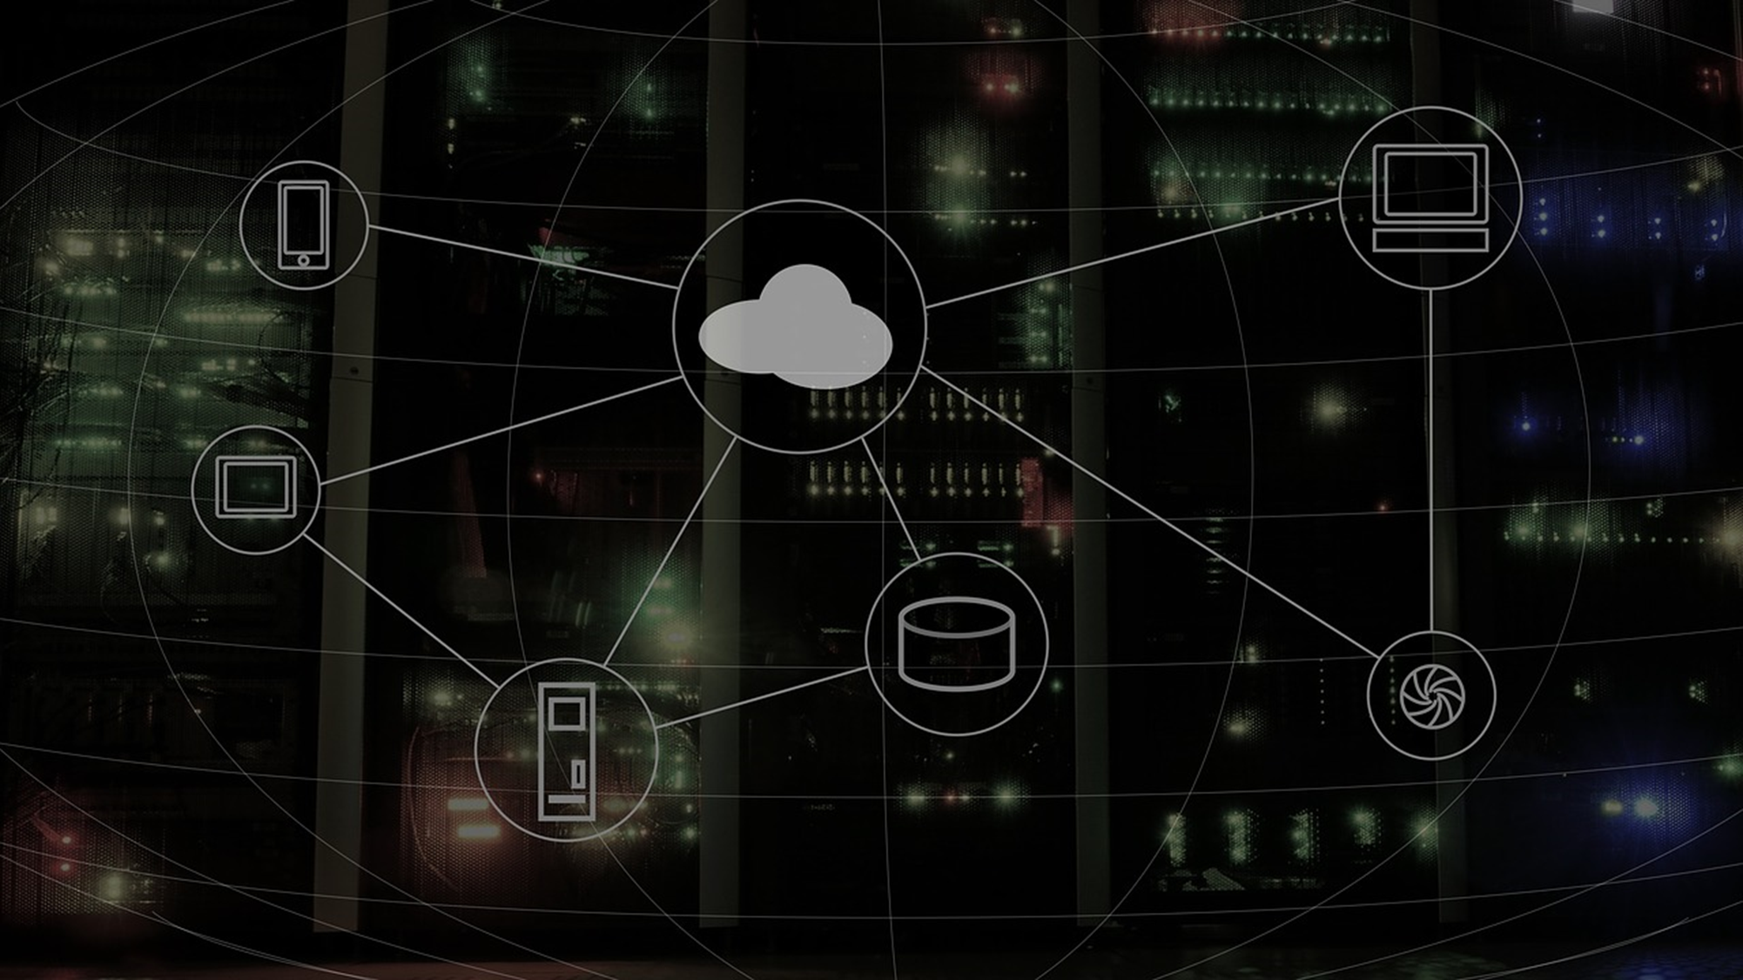
What is the right size of servers for my business needs?
How can I increase server utilization?
How many servers do I need?
How can I scale my app?
How often should I patch my servers?
How do I deploy new code to my server?
How often should I backup my server?
Which OS should I use?
Which packages should be on my server?
Who monitors my App?
On-Premises
IaaS

Slide 8

What is the right tier for my business needs?
How can I increase compute utilization?
How many instances do I need?
How can I scale my app?
On-Premises
IaaS
PaaS

Slide 9

How do I architect my app?
On-Premises
IaaS
PaaS
Serverless
Notes:
Scalability
Pricing pay as you go
Just bring application
From paas is where the value is
Containers is IaaS++

Slide 10

What is “Serverless”
Abstraction of servers
Event-driven scale
Sub-second billing

Slide 11

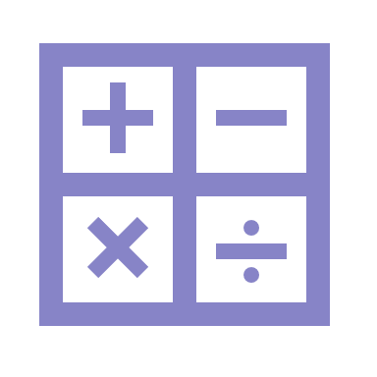
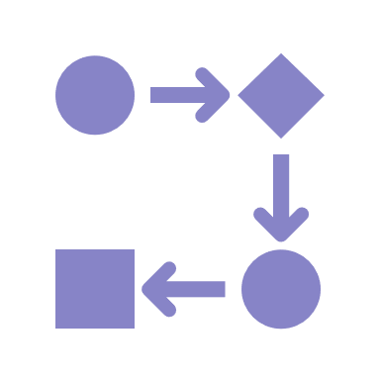

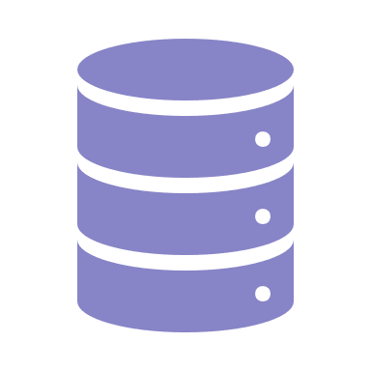



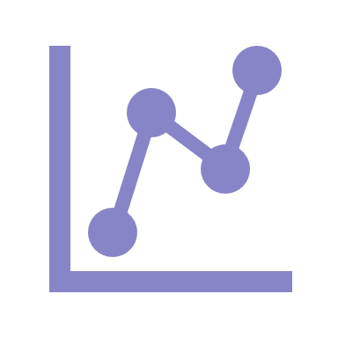
Azure Serverless vs. PaaS
Compute
Workflow
Events
Database
Realtime
IoT
Messaging
Analytics

Slide 12

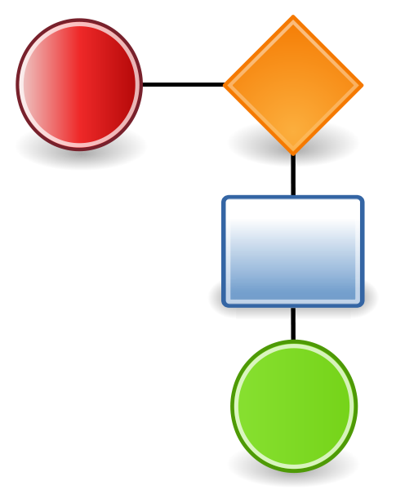

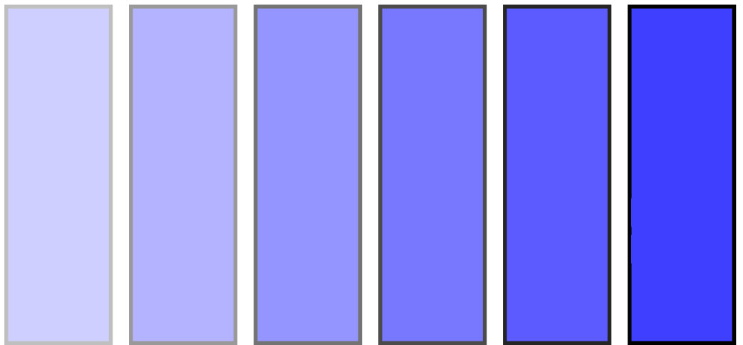
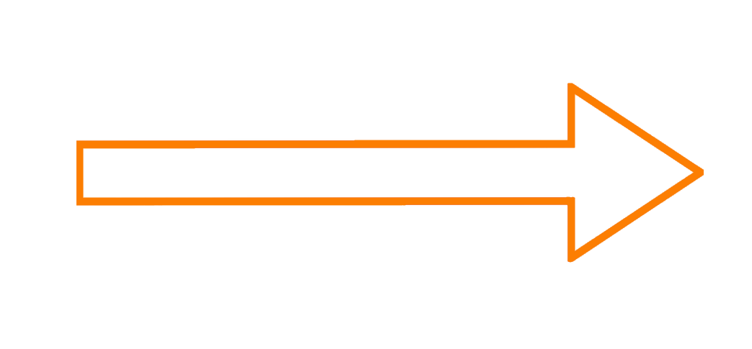
Processing Trinity
Workflow
Compute
Eventing

Slide 13
Workflow

Slide 14
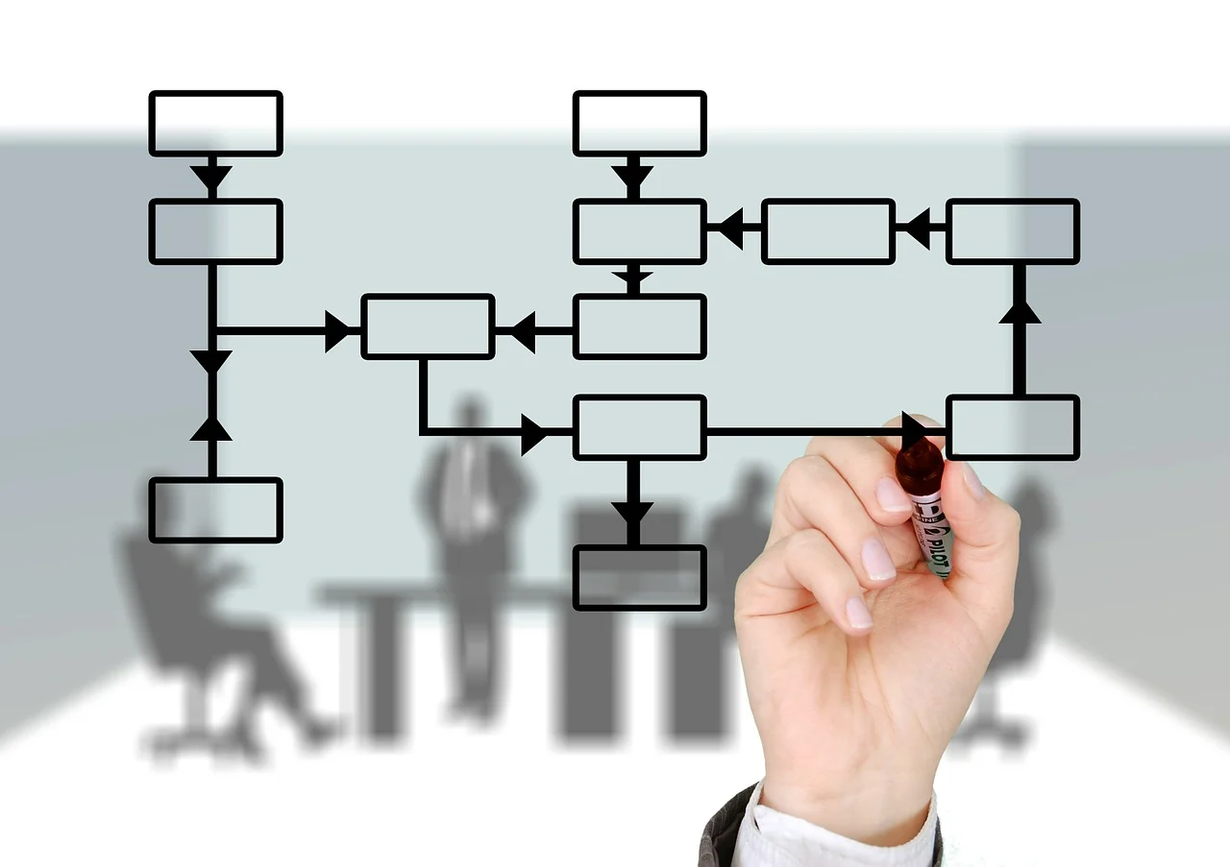
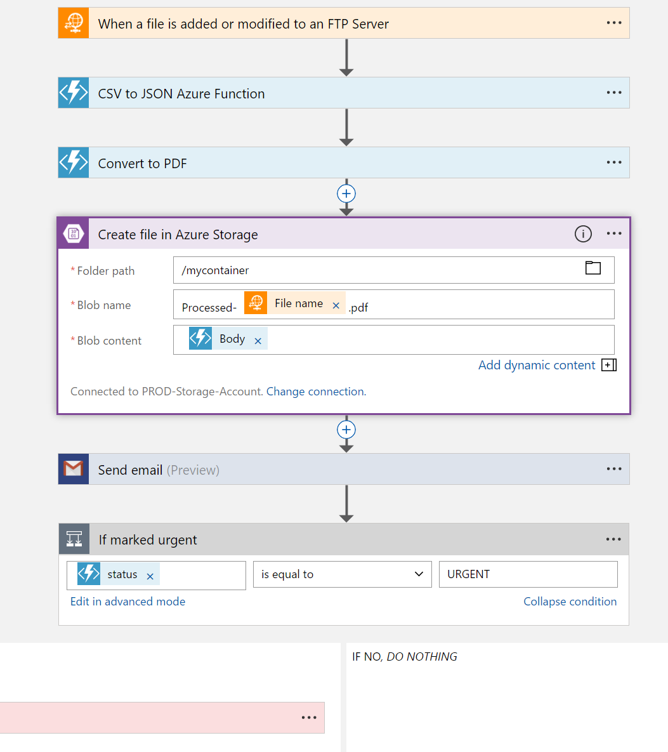
Logic Apps
Visual Designer
Workflow, triggers and actions
Applications, data and services
Enterprise Integration
Notes:
Faster integration using innovative Visual Designer
Easy workflow creation with triggers and actions
Mashup applications, data and services
Built for mission critical Enterprise Integration
Create, deploy, manage and monitor

Slide 15

Connected
Cloud APIs and platform functionality
Over 250 OOTB connectors
Hosted and managed
Scalable
Rapid development
Open source
API connections
Authenticate once and reuse
Simple to deploy
Easily manageable

Slide 16

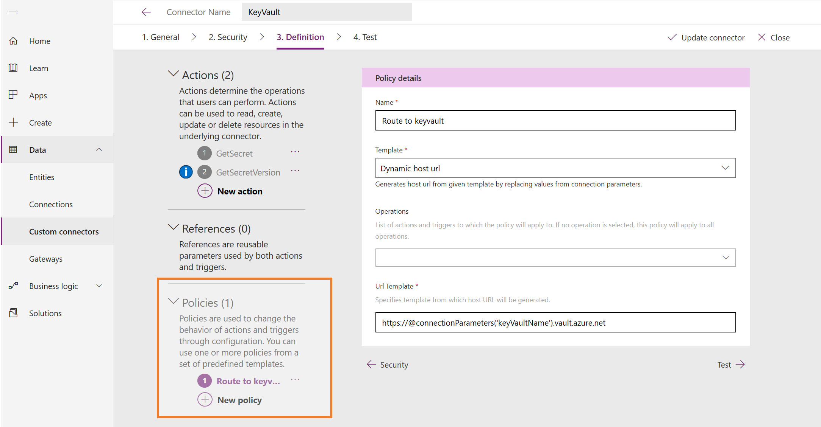
Custom Connectors

Slide 17
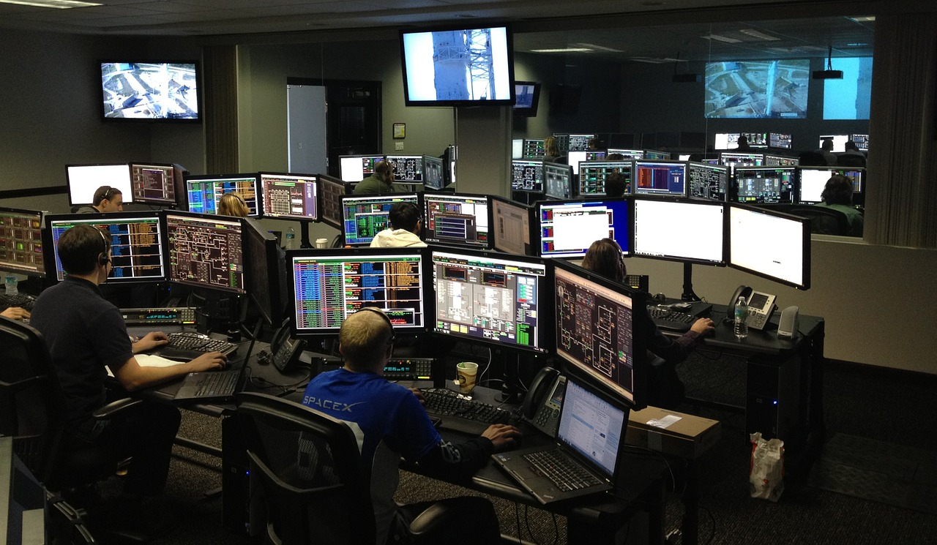





Monitoring & Tracking
Trigger & Run History
Monitoring view
Diagnostics
Alerts
Tracked properties

Slide 18
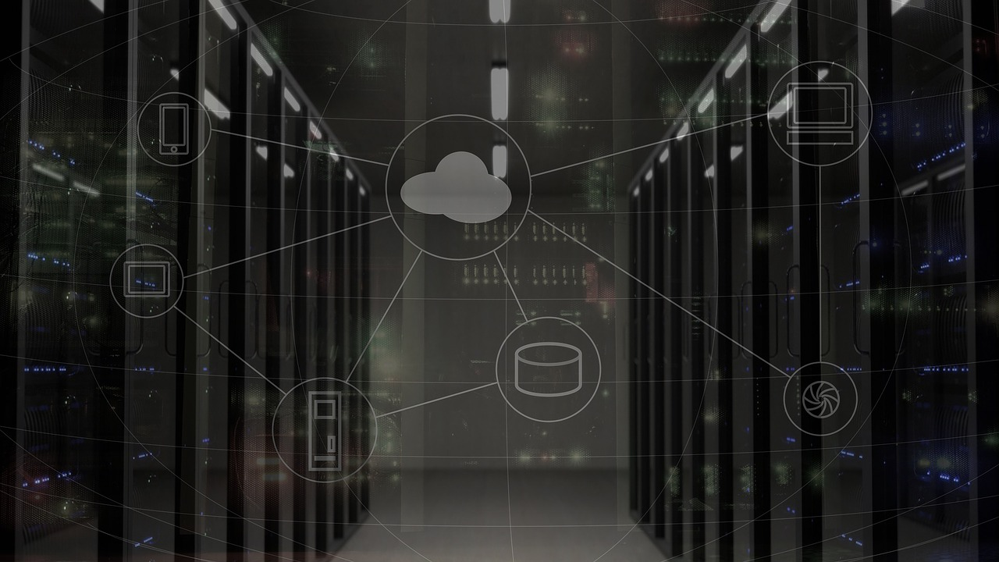
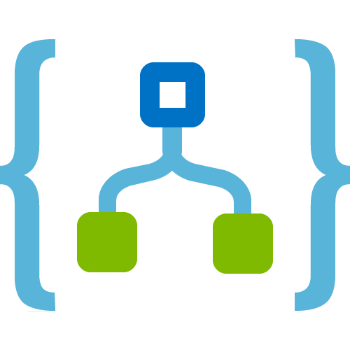



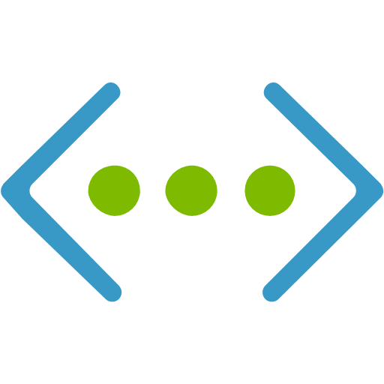







Hybrid Integration
On-premises Data Gateway
Azure API
Management
Azure Service Bus
Logic Apps
Logic Apps
Logic Apps
GatewayCloud Service
APIM
Azure Service Bus relay
Virtual network or public
Queues
Topics
Gateway
Data Sources
LOB
Systems
SOAP web services
Backend
APIs
API-based
Notes:
Without opening firewall

Slide 19

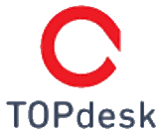


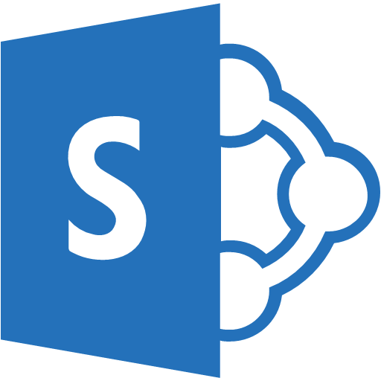
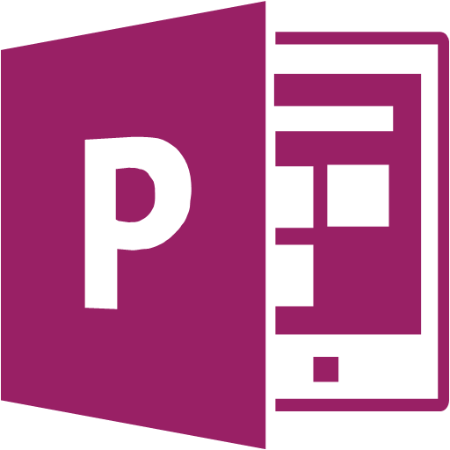
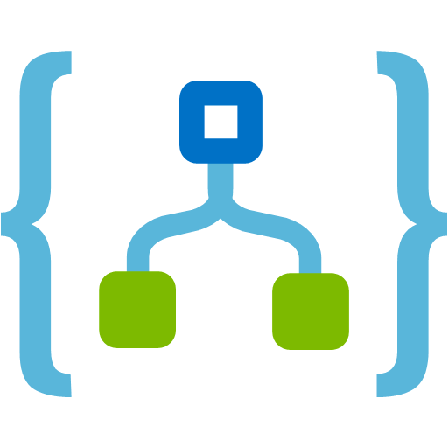
Demo – Onboarding Process

Slide 20
Compute

Slide 21


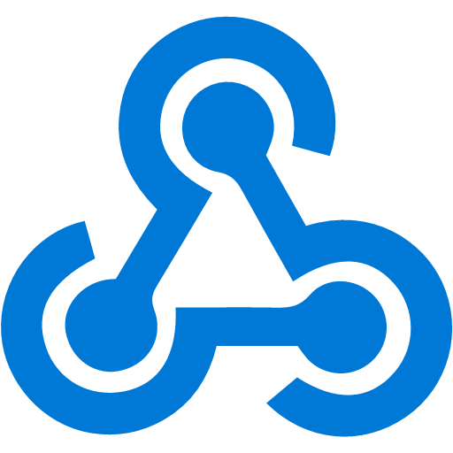

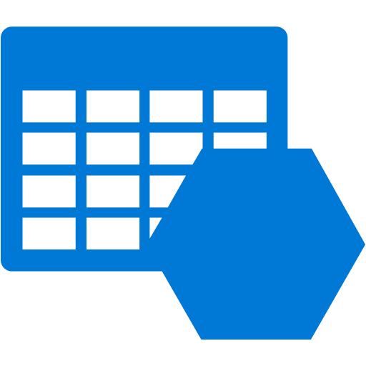


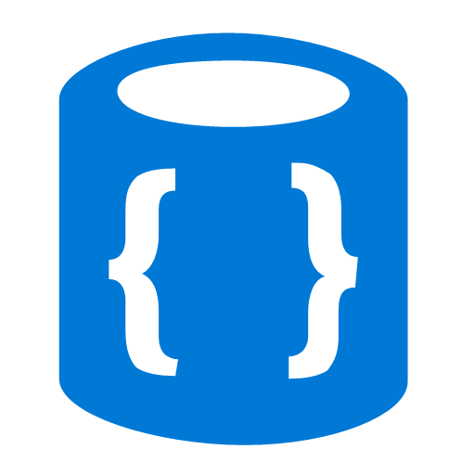

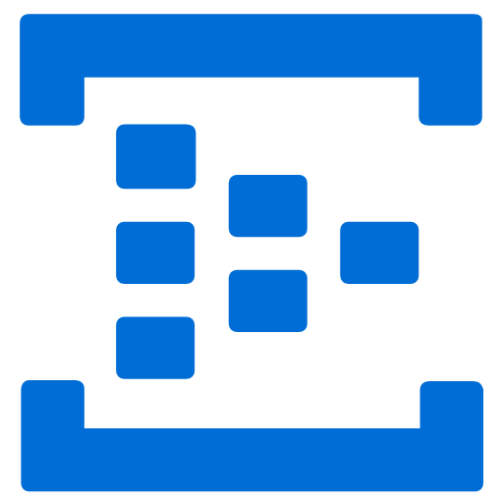
Azure Functions
Events
Code
Outputs
React to timers, HTTP, or events from your favorite Azure services, with more on the way
Author functions in C#, F#, Node.JS, Java, and more
Send results to an ever-growing collection of services

Slide 22

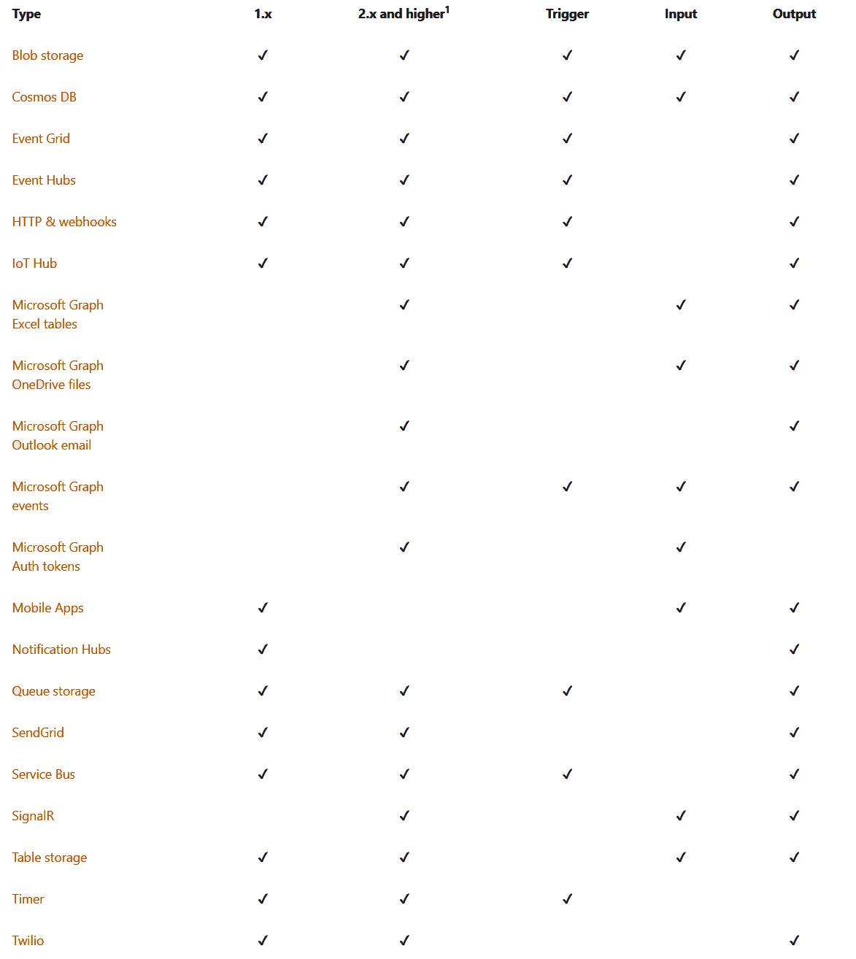
Functions Triggers and Bindings

Slide 23



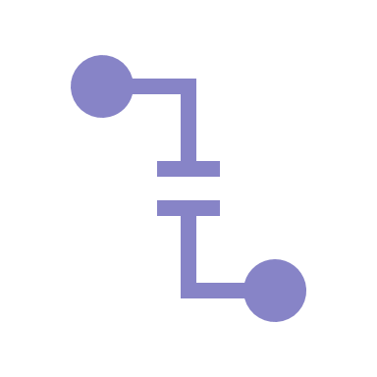
Function bindings
Low-code access to external sources
23 bindings
Ideal for “data-in, data-out” scenarios

Slide 24





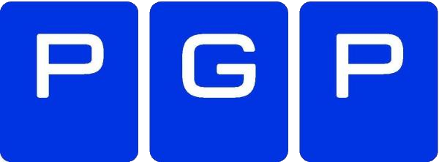
Demo – PGP Decryption

Slide 25
Eventing

Slide 26

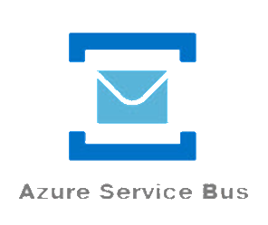
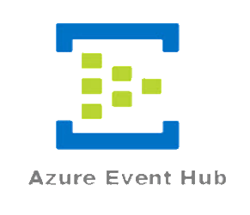
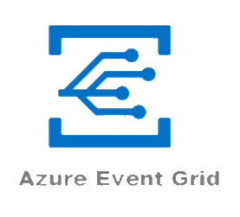
Service Bus Services
Messaging
Transactions
Control
Pull
Series Events
Telemetry
Streaming
Discrete Events
Event Handling
Reactive
Push

Slide 27


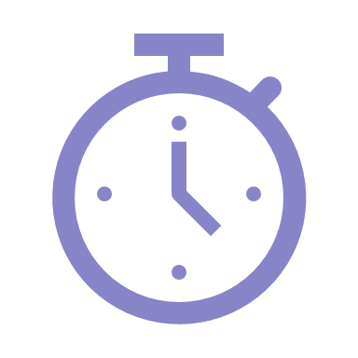

Azure Event Grid
Fully-managed event routing
Near real-time event delivery at scale
Broad coverage within Azure and beyond

Slide 28




Benefits
Focus on innovation and pay per event
Ensure reliability and performance for your apps
Unlock new scenarios for your apps

Slide 29

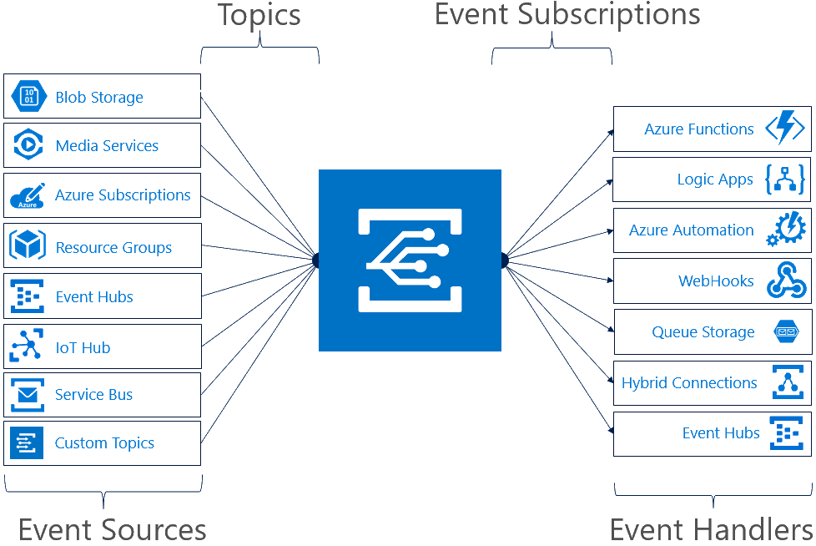
Concepts
Events: what happened
Event Publishers: where it took place
Topics: where publishers send events
Event Subscriptions: how you receive events
Event Handlers: the app or service reacting to the event

Slide 30

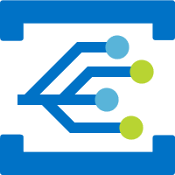
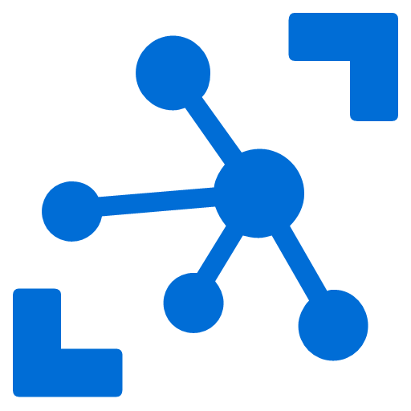
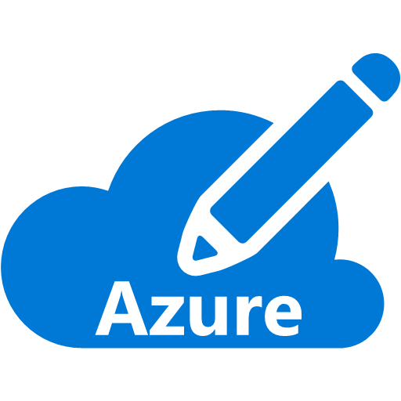



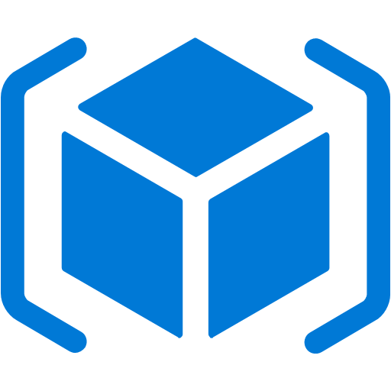
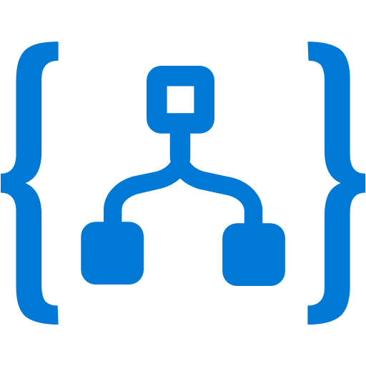


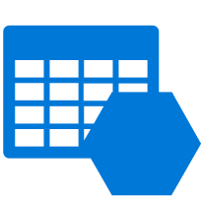

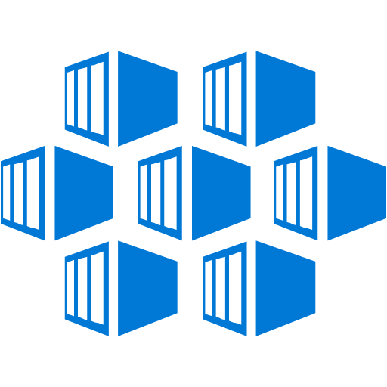
Azure Event Grid + CNCF CloudEvents
…
Google Cloud
SAP Cloud
…
Oracle Functions
Flexible
Interoperability
IoT Hub
AWS Lambda
Blob Storage
Azure Subscriptions
Azure Functions
Resource Groups
Logic Apps
Event Hubs
Azure Automation
WebHooks
Custom Topics
Event Hubs
Storage (GPv2)
Storage Queues
Container Registry
Multi-Cloud Solutions
Service Bus
Google Cloud Fn
IBM Cloud
Oracle Cloud
…
IBM Cloud Fn
…
Notes:
CloudEvents simplifies interoperability by providing a common event schema for publishing, and consuming cloud based events.
This schema allows for uniform tooling, standard ways of routing & handling events, and universal ways of deserializing the outer event schema.
With a common schema, you can more easily integrate work across platforms.

Slide 31

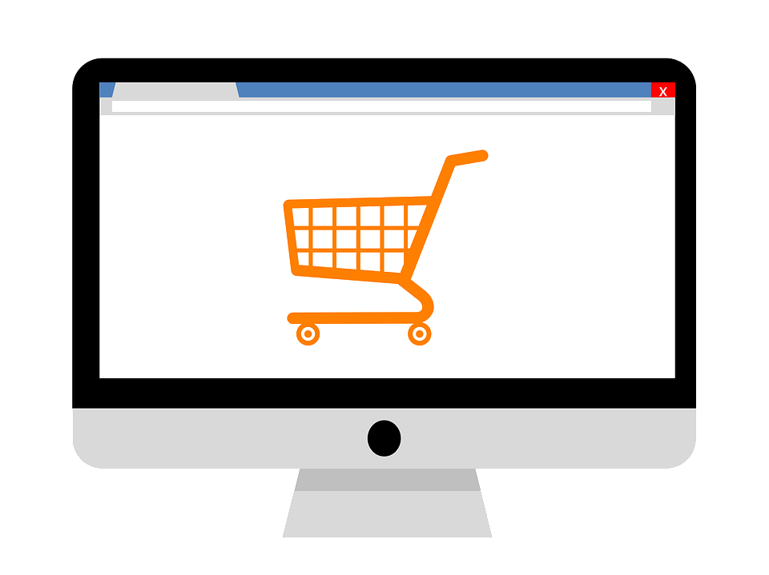
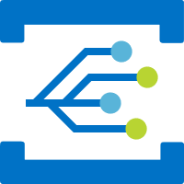

Demo – Eventing

Slide 32
Bringing it all Together

Slide 33


Azure Serverless Components
Event Grid
Logic Apps
Functions
Manage all events that can trigger code or logic
Design workflows and orchestrate processes
Execute your code based on events you specify

Slide 34




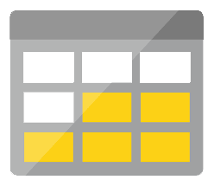
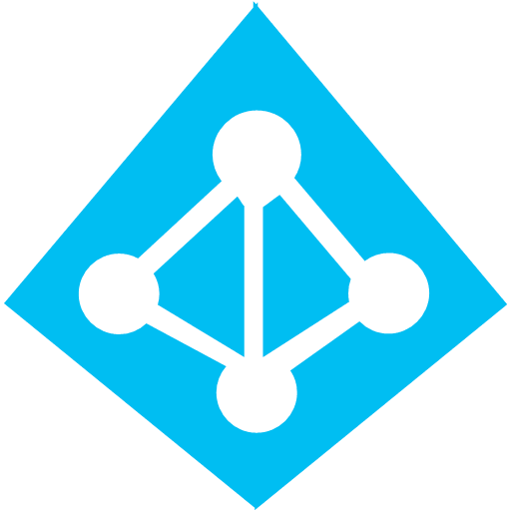



Azure Serverless Components
Platform
Event Grid
Logic Apps
Functions
Manage all events that can trigger code or logic
Design workflows and orchestrate processes
Execute your code based on events you specify
API Management
Container Instances
Application Insights
Scalable API gateway for securing, publishing, and analyzing APIs
Run application containers in the cloud with a single command
Extensible Application Performance Management service
Database
Storage
Security
IoT
Analytics
Intelligence

Slide 35

Azure Serverless Components
Development
Platform
Event Grid
Logic Apps
Functions
IDE support
Manage all events that can trigger code or logic
Design workflows and orchestrate processes
Execute your code based on events you specify
Integrated DevOps
API Management
Container Instances
Application Insights
Local Development
Scalable API gateway for securing, publishing, and analyzing APIs
Run application containers in the cloud with a single command
Extensible Application Performance Management service
Monitoring
Database
Storage
Security
IoT
Analytics
Intelligence
Visual Debug History

Slide 36

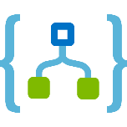


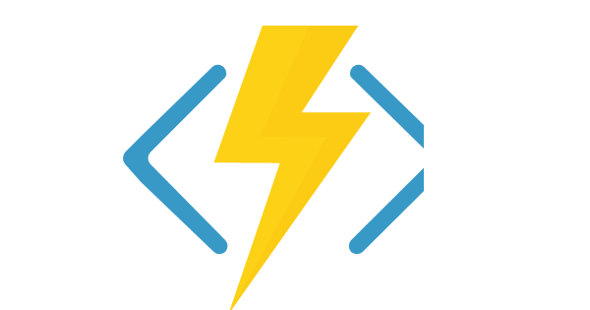
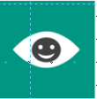
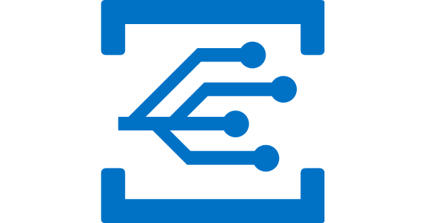

Better Together
Limitless Possibilities

Slide 37




Demo – Order System

Slide 38
Almost done…

Slide 39

Key Takeaways
Serverless
Focus on value
Cost Efficient
Only pay for what you use
Better Together
Combine services to create powerful scenarios

Slide 40




Thank You!
@egrootenboer
eldert@eldert.net
https://www.linkedin.com/in/eldert-grootenboer
Notes:
Rustig spreken!

